Slide 1
Business Analytics With R
Magesh Tarala
Fall 2024

Slide 2
About Me
Career in Information Technology
Closely follows the info tech evolution
Leadership Roles in Corporate World
Telecom, Residential Mortgage, Insurance, Banking, Aerospace & Defense, etc.
Entrepreneur
Software, Data & Analytics, Real Estate

Slide 3
Today’s Lecture
Introduction of the Course
Introduction to Business Analytics
Notes:
How to use quantitative data to help with decision making
Book definition “Practice and Art of brining quantitative data to bear on decision-making”

Slide 4
Course Objectives
Acquire foundational knowledge of business intelligence and data mining
Explore various real-world use cases to understand its practical applications
Foster practical understanding in data preparation, exploration, and visual analytics methods
Effective data analysis and interpretation for informed decision-making
Gain hands-on experience in predictive modeling, classification, clustering, and association rules
Empowering you to solve complex business challenges using data-driven insights.
Use R as the medium to accomplish the objectives
Prior coding experience is a great plus, but not a requirement

Slide 5
Course Overview
Data Exploration and Visualization
Data Preparation
Supervised and Unsupervised Learning
Prediction
Classification
Clustering
Association Rules & Collaborative Filtering
Model Selection and Evaluation
Notes:
While we will be using R for this course, teaching R syntax or learning R as a language is not the primary focus of this course.

Slide 6
Class Resources
eLearning (Blackboard)
Announcements
Syllabus (Tentative syllabus, subject to change)
Lecture Materials – slides, code, data files, etc.
Assignments
Signup for Groups
DataCamp
Notes:
While we will be using R for this course, teaching R syntax or learning R as a language is not the primary focus of this course.

Slide 7
Course Components
Theoretical Component
Statistical concepts
Machine learning algorithms
You DO NOT need to understand every detail of how an algorithm is implemented.
You DO need to know when & how to apply an algorithm.
Practical Component
Hands-on programming in R
Real-world business analytics problems
You DO need to understand every concept and each line of code!

Slide 8
Course Organization
Lectures & Labs
Lecture: mostly my presentation
Lab: mostly your coding
Course Materials - eLearning
Lecture & R code: updated weekly

Slide 9

In-class & After-class Learning
Always be prompt on course-related tasks.
Never hesitate to ask questions.
Learn to use online resources. For example:
Stack Overflow
R-bloggers

Slide 10
Office Hours/Contact Information
TA:
muneet.singh@utdallas.edu
First contact for questions about homework, lab exercise, grading
Office Hours: Thursdays from 12:00 PM to 1:00 PM via MS Teams
Instructor:
magesh.tarala@UTDallas.edu
Unresolved questions
Office Hours (Online): Thursdays 3:00pm – 4:00pm (MS Teams). Appointments are encouraged.
Email Modalities:
Start email subject with filters such as HW1, LAB, and R.
Use only UTD email account

Slide 11
Assessment and Grading
R DataCamp Training. 2 courses, 2.5% each. Total 5%
4 Assignments, 5% each. Total 20%
2 Exams, 25% each. Total 50%
Group Project, 25%
The final cut-offs could be adjusted at the end of the semester based on the following rules: The portion of “A” grade will not exceed 30% of the number of students. The portion of “A-” grade will not exceed 30% of the number of students.
Letter Grade | Final Point Total
A | >= 93.00 – 100
A- | >= 90.00 – 92
B+ | >= 88.00 – 89
B | >= 83.00 – 87
B- | >= 80.00 – 82
C+ | >= 78.00 – 79
C | >= 73.00 – 77
F | 0 – 72

Slide 12
Textbook
Data Mining for Business Analytics: Concepts, Techniques, and Applications in R, by Galit Shmueli, Peter Bruce, Inbal Yahav, Nitin Patel, and Kenneth Lichtendahl. Wiley, ISBN-10: 1118879368, ISBN-13: 978-1118879368
R for Data Science by Grolemund and Wickham, http://r4ds.had.co.nz/index.html
eLearning -> Announcements -> DataCamp free account creation via my invited link

Slide 13
Is this Course Right for You?
This is a hands-on, data-intensive course.
Please think carefully.
Do you have a strong will to learn things that are unfamiliar to you?
Are you devoted to obtaining and demonstrating analytical skills to your potential employers?
Participation and Practice are very important!

Slide 14
Student Resources
Academic Stress and Resources
Technology Access
Mental Health and Wellbeing
Basic Needs

Slide 15

Questions?

Slide 16
Introductions
Name
Undergrad Major
Current Major and Specializations
Work Experience
Anything else you want to say about yourself

Slide 17
Introduction to Business Analytics

Slide 18
Some Definitions
Business Analytics: Practice and Art of bringing quantitative data to bear on decision making
Business Intelligence: Data Visualization and Reporting for Understanding (Still relevant?)
Data Mining: Methods that go beyond counts, descriptive techniques, reporting and business rules
Advanced Analytics, Predictive Analytics, Predictive Modeling, Machine Learning, Artificial Intelligence, Big Data, Data Science

Slide 19
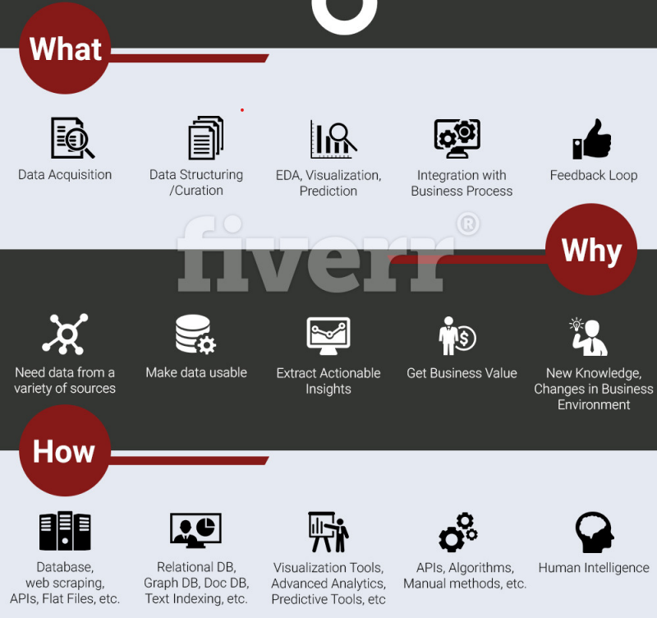
Lay of the Land

Slide 20
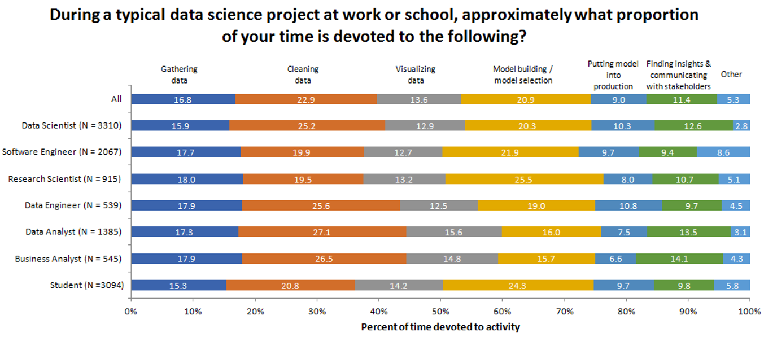
Kaggle Survey

Slide 21
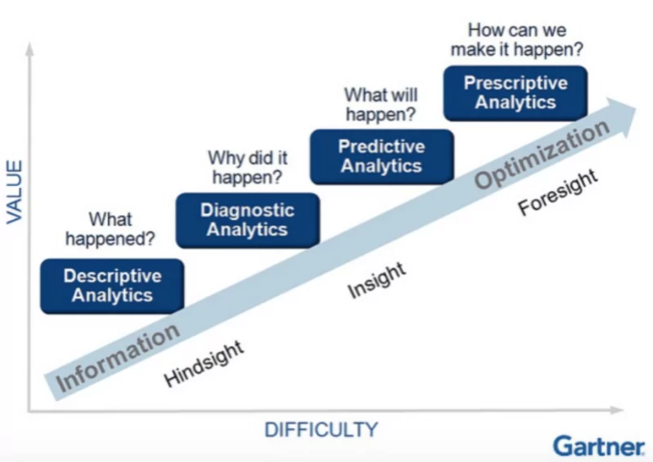
Value Escalator

Slide 22
Descriptive Analytics
Sales Analysis: A retail company examines its sales data over the past year to identify which products sold the most, which regions had the highest sales, and which months experienced a sales peak.
Website Traffic Report: An online business reviews website traffic data to determine the most popular pages, the sources of incoming traffic (e.g., search engines, social media), and the times when the website receives the most visits.
Inventory Management: A manufacturing company reviews inventory data to identify which products have the highest turnover rate, which items are frequently out of stock, and which products have surplus stock.
Energy Consumption Patterns: An energy company studies data on energy consumption to identify peak usage times, energy consumption trends across different user segments, and factors influencing demand.

Slide 23
Predictive Analytics
Supervised Learning (Classification)
Classifying loan applicants into different risk categories (Classification)
Predicting whether a bank transaction is normal or fraudulent
Supervised Learning (Regression/Prediction)
House price prediction
Sales forecasting
Clustering (unsupervised learning)
Customer segmentation: fresh-food lovers vs. convenience junkies
Health insurance companies often identify “clusters” of consumers who share similar attributes, and actuaries will use such information to set premiums for different clusters, based on how often a specific cluster will use the insurance.

Slide 24
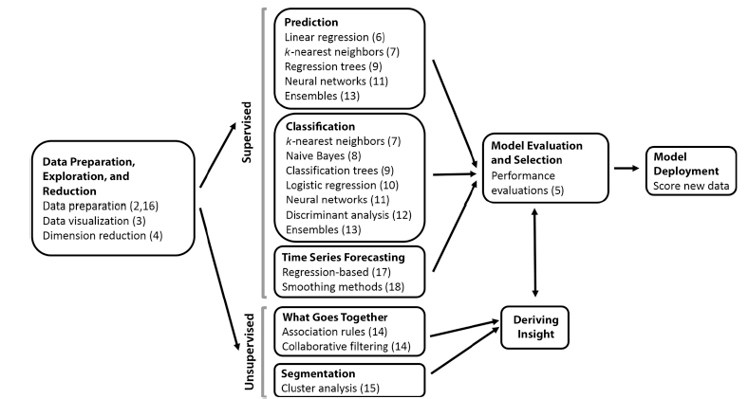
Data Mining Process

Slide 25
Key Terminology
Predictor, Feature, Input Variable, Independent Variable, or from a database perspective a field.
Response, Dependent Variable, Output Variable, Target Variable or Outcome Variable
Observation, Instance, Sample, Example, Case, Record, Pattern or row
Training data, Test data, Validation data
Model

Slide 26
Why Business Analytics?
Because of Data Explosion
Database technology, cheap storage, and the universal adoption of the Internet
Data are everywhere
More than 5 billion people currently access and store data on their digital devices and in the cloud. Roughly 7.5 billion people will be doing the same by 2030.
Cybersecurity Ventures predicts 338 billion lines of new software code will be generated in 2025, up from 111 billion in 2017.
The IoT market is due to reach 31 billion connected devices in 2020 and 75 billion IoT devices by 2025, according to Cisco.
The world will store 200 zettabytes of data by 2025
A zettabyte is enough storage for 30 billion 4K movies, or 60 billion video games, or 7.5 trillion MP3 songs according to Seagate.
Source: https://www.prnewswire.com/news-releases/the-world-will-store-200-zettabytes-of-data-by-2025-301072627.html
Notes:
Many predictive models, especially in traditional statistical analysis, often use relatively small datasets and a limited number of predictors. However, Big Data still plays a significant role in the field of predictive modeling in several important ways:
1. Model Training and Validation
Training on Large Datasets: Even if the final model is applied to a smaller dataset, the training process itself can benefit from Big Data. Large datasets allow for better training of machine learning models by providing more examples, which helps in learning complex patterns and reducing overfitting. For example, models like neural networks or gradient boosting machines perform better when trained on vast amounts of data.
Model Validation: Big Data allows for extensive validation and testing of models across different subsets of data. This improves the generalizability of the model, ensuring that it performs well on unseen data. Even if the model uses a small number of predictors, the robustness of its validation process can be enhanced by Big Data.
2. Feature Engineering and Selection
Exploratory Feature Engineering: With access to large datasets, analysts can experiment with a vast array of potential features. Big Data enables the discovery of novel predictors that might not be apparent in smaller datasets. Feature engineering using Big Data can involve creating new features from the existing ones, detecting interactions between variables, and selecting the most predictive ones.
High-Dimensional Data: While the final model may use a small number of predictors, the initial data exploration might involve many more variables. Big Data helps in identifying and selecting the most relevant features, either through automated methods (like regularization techniques in machine learning) or through more manual processes.
3. Ensemble Methods
Ensemble Modeling: Big Data is particularly advantageous for ensemble methods, where multiple models are trained and combined to improve prediction accuracy. These models can be trained on different subsets of data, or on different sets of predictors, taking full advantage of the richness and variety provided by Big Data. This approach can lead to better performance even when the final ensemble uses a smaller number of predictors.
4. Contextual and Real-Time Analytics
Contextual Predictions: Even if the main predictive model uses a limited set of features, Big Data can provide the context within which these predictions are made. For example, a simple model predicting customer churn might use just a few key variables, but Big Data can offer additional context such as recent behavioral patterns, social media interactions, or external market conditions, which can be used to adjust or refine the predictions.
Real-Time Data Streams: In many applications, predictive models need to be updated frequently as new data arrives. Big Data systems support real-time data processing, allowing models to be continually refined and recalibrated with the latest information, even if the model itself uses a small number of predictors.
5. Handling of Rare Events
Detection of Outliers and Rare Events: In fields like fraud detection or predictive maintenance, Big Data is crucial for identifying rare events. Even if the predictive model uses a small number of features, having access to a large dataset helps in accurately identifying these rare occurrences, which might not be possible with smaller datasets.
6. Data Augmentation and Synthesis
Creating Synthetic Data: Big Data can be used to generate synthetic data that helps in augmenting smaller datasets, which can then be used to train models that generalize better. For instance, in image recognition tasks, large datasets can be used to create augmented data, which improves the model's performance even when the actual prediction task involves fewer variables.
Conclusion
While it’s true that many predictive models use a relatively small number of records and predictors, Big Data still plays a crucial role in enhancing the development, training, and validation of these models. The richness, diversity, and scale of Big Data enable more robust and accurate predictive modeling, even when the end models themselves are relatively simple.

Slide 27
Why Business Analytics?
Because It Creates Business Value
For firms
The Evolution of Decision Making: How Leading Organizations are Adopting a Data-Driven Culture (HBS Review)
Increased productivity, reduced risks, cost reduction, faster decision making, improved financial performance, etc.
For consumers
Personalized recommendation, precision medicine, etc.
Data rich, yet knowledge poor
only small portion (~5-10%) of collected data is analyzed
existing analysis leaves much for improvement
Winning the talent war!
Victor Nilson (former senior vice president of big data at AT&T): ”AT&T has a rich wealth of data. But without talent, it’s meaningless. Talent is the differentiator.”
Zoher Karu (former vice president of global customer optimization and data at eBay): ”Talent is critical along any data and analytics journey.”

Slide 28
Why Business Analytics?
And Value for You
MIT Sloan Management Review (Jun 16, 2020)
“In 2019, LinkedIn ranked “data scientist” the No. 1 most promising job in the U.S. based on job openings, salary, and career advancement opportunities and reported a 56% rise in job openings for data scientists over the previous year. “
“In a recession, when there will be an increased emphasis on cost cutting and efficiency, there should be an increased demand for prescriptive analytics.“
“Optimization will be applied to everything from production to logistics to human resource management, and analytically mature organizations should see an increase in demand for data science services.”
https://sloanreview.mit.edu/article/the-recessions-impact-on-analytics-and-data-science/

Slide 29

As hurricane Frances was bearing down on Florida in 2004
Walmart’s CIO Linda Dillman asked her staff to analyze data to see if the stocking of stores in the affected areas should be changed in advance of the hurricane
React before the event, driven by data.
Analyze the data from previous hurricanes
Some obvious – stock more bottled water, flashlights
Some not so: How much more? How many cashiers are needed?
Discover surprising things: Strawberry pop-tart sales were seven times higher in stores in areas expecting a hurricane
Notes:
some recent examples of companies that have successfully implemented predictive modeling:
JPMorgan Chase:
Fraud Detection: JPMorgan Chase has implemented AI-driven predictive models to enhance fraud detection capabilities. The bank uses machine learning algorithms to analyze millions of transactions daily, identifying potentially fraudulent activities in real time. This has significantly reduced the occurrence of fraud and minimized financial losses for the bank​
Johnson & Johnson:
Predictive Analytics in Healthcare: Johnson & Johnson has been using predictive modeling to improve healthcare outcomes. For example, predictive models help the company anticipate equipment failures in medical devices, allowing for timely maintenance and reducing downtime. This ensures that critical medical equipment is always operational, thereby improving patient care​
Amazon:
Customer Behavior Prediction: Amazon utilizes predictive models to analyze customer behavior and provide personalized recommendations. By predicting what products customers are likely to purchase based on their browsing and purchase history, Amazon has significantly increased sales and customer engagement. This approach has been a cornerstone of Amazon's e-commerce success​
NVIDIA:
Financial Modeling: NVIDIA has leveraged AI in financial modeling to predict market trends and optimize trading strategies. The company reports that its predictive models have had a positive impact on revenue, with 86% of financial institutions using NVIDIA’s AI tools experiencing improved financial outcomes

Slide 30

Netflix is quietly transforming the entertainment industry with data.
By analyzing plays, ratings, and searchers, Netflix is able to:
Personalize Recommendations: personalized video ranking, trending now ranker, continue watching ranker, video-video similarity ranker
Content Development Analytics: Netflix’s studio execs knew Umbrella Academy was going to be a hit because it hit user touchpoints that have proven to be successful in the past. Besides, Netflix can identify and target users who are attracted to these touchpoints.
Optimize production planning: Netflix uses analytics to optimize everything from the user experience on the app to on the ground logistics for shoots, such as project cost of filming in one location vs. another.

Slide 31

Big Mac to Big Data: Why Mcdonald’s is betting its future on digital innovation (HBS)
Investing in big data to understand customers better.
In 2019, the company paid $300 million to acquire the machine learning firm Dynamic Yield. With data and algorithmically driven decision making, McDonald’s drive through’s are outfitted with digital menus that change its offerings and tailors promotions based on the weather, time of day, local traffic, nearby events, and historical sales data.
The business has been able to use digital innovation as a driver for growth, producing 5.4% increase in global sales for the first quarter of 2019.

Slide 32

Google’s Quest to Build a Better Boss
Google’s people analytics teams dug deep into their data and analyzed employee performance reviews and feedback surveys to understand “what makes a better boss”.
The output is “Google’s Rules” — Eight Good Behaviors and Three Pitfalls of Managers — for how to be a better boss.
This leads to a statistically significant improvement in manager quality for 75% of the lowest-performing managers.

Slide 33
To Do List
Check the syllabus
Install R and RStudio
Form your group (4 members)
We will use sign-up sheet in eLearning to register your team. No need to email me now about your team composition.
eLearning -> Sign Up for Groups
Cross-session group is NOT allowed
R Assignment

